Slide 1
Retail Sales & Inventory Intelligence System

Slide 2
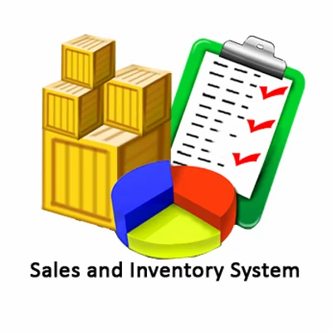
Objectives
Analyze overall business performance
Identify top-performing and underperforming segments
Join related tables
Understand geographic sales distribution
Study sales patterns over time
Enable interactive and actionable insights

Slide 3
Visual aid
(Dashboard)

Slide 4
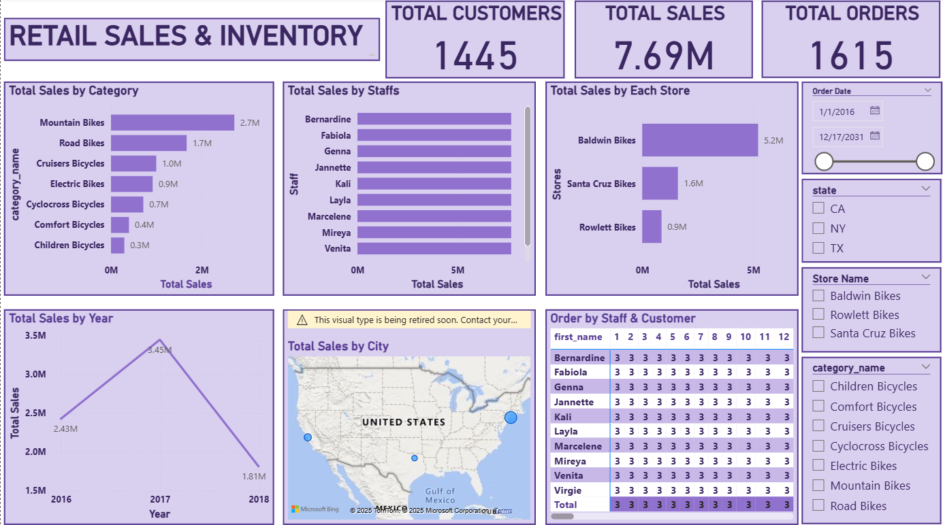

Slide 5
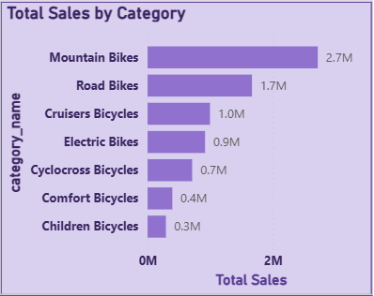
Chart 1- Total Sales by Category
Mountain Bikes dominate the sales landscape with revenue of 2.7M, accounting for the largest share.
Road Bikes follow with 1.7M, showing strong performance but still trailing significantly behind Mountain Bikes.
The remaining categories are on or fall below 1M, indicating a steep drop-off in sales volume beyond the top two

Slide 6
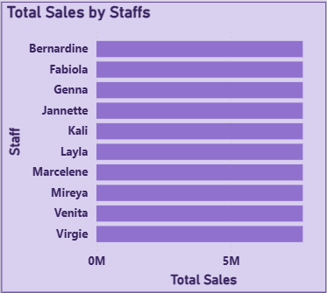
Chart 2- Total Sales by Staffs
All ten staff members — Bernardine, Fabiola, Genna, Jannette, Kali, Layla, Marcelene, Mireya, Venita, and Virgie have exactly the same total sales value.
The bars are identical in length, suggesting either:
A data aggregation issue, or
A business rule where sales are evenly distributed (e.g., pooled commissions or shared quotas).

Slide 7
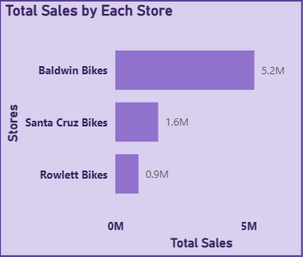
Chart 3- Total Sales of Each Store
1. Baldwin Bikes is the clear leader
Its sales are more than 3x that of Santa Cruz and nearly 6x Rowlett.
This suggests strong customer traffic, better product mix, or superior sales execution.
2. Santa Cruz Bikes holds mid-tier ground
While not close to Baldwin, it still contributes meaningfully.
Could be optimized further with localized marketing or bundling strategies.
3. Rowlett Bikes may need attention
Its low sales could stem from:
Limited inventory or product range
Poor visibility or location
Staffing or service issues

Slide 8
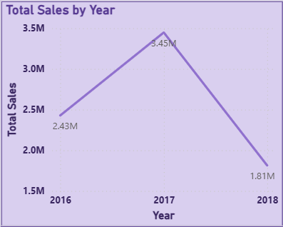
Chart 4- Total Sales by Year
2017 stands out as a high-growth year — a 42% jump from 2016 suggests strategic success,
2018’s drop is significant — nearly half the sales of 2017. This could be due to:
- Inventory shortages
- Reduced marketing spend
- Economic or seasonal downturns
- Data gaps or reporting inconsistencies

Slide 9
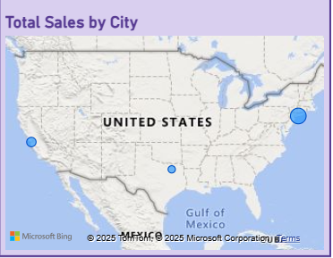
Chart 5- Total Sales by City
1. Baldwin is the clear sales powerhouse
- Its sales are 3.25x higher than Santa Cruz and 6x Rowlett.
- This suggests strong local demand, optimized operations, or possibly a broader product mix.
2. Santa Cruz shows potential
- While not close to Baldwin, it still contributes significantly.
- Consider analyzing category-level performance here — are certain products driving the bulk of sales?
3. Rowlett may need strategic support
- Its lower sales could stem from:
- Limited inventory or product range
- Lower brand visibility
- Demographic mismatch or location challenges

Slide 10
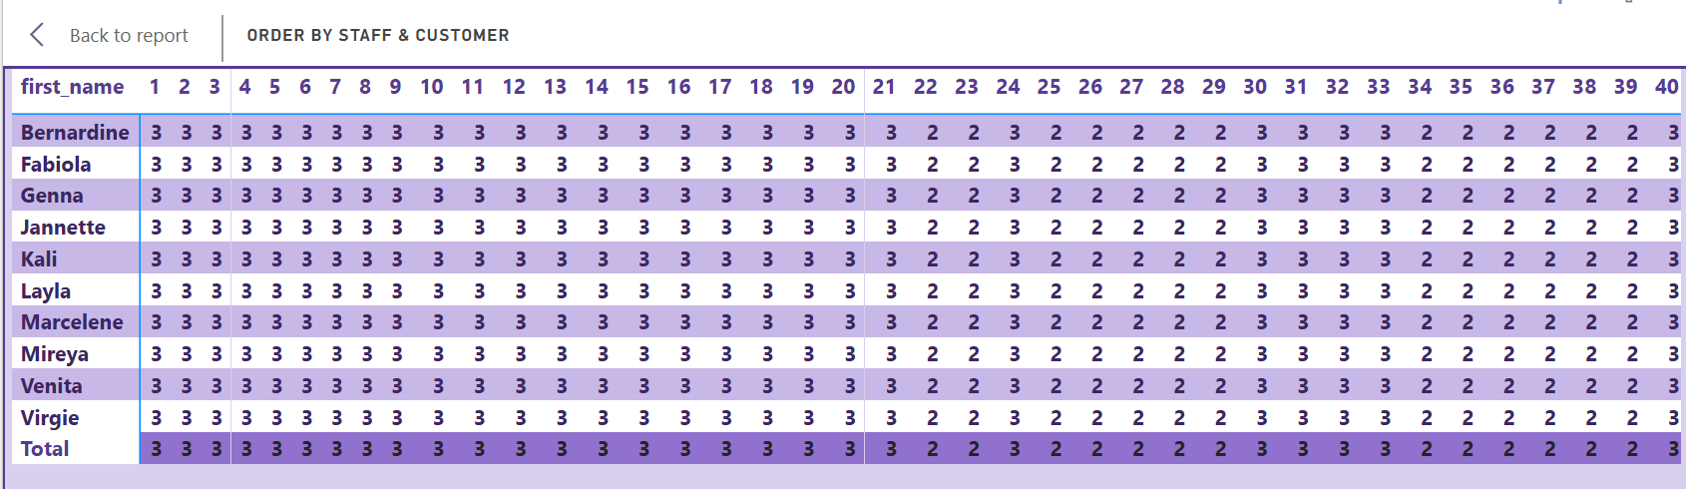
Chart 6- Order by Staff and Customer
The matrix is wide, suggesting each staff member has interacted with 40+ customers.
The values range from 1 to 3, which mean number of orders
The “Total” row aggregates each column, showing how active each customer is across all staff

Slide 11
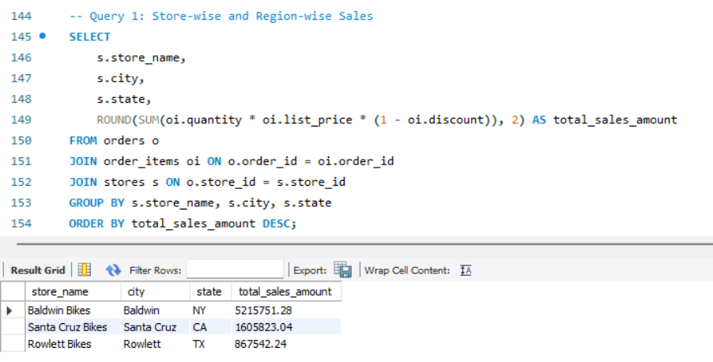
SQL Insights
Insight 1 Store & Region-wise Sales

Slide 12
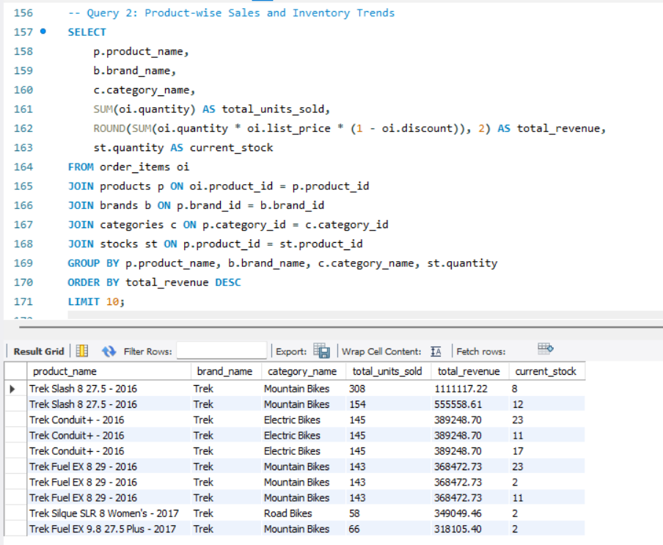
Insight 2 Product-wise Sales & Inventory Trend

Slide 13
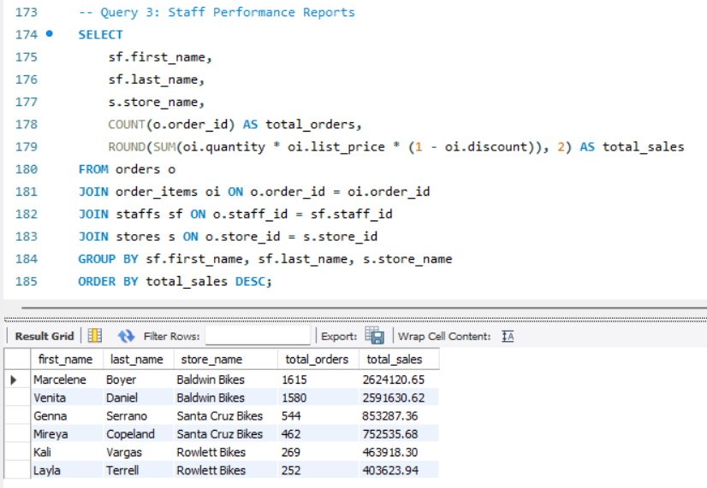
Insight 3 Staff Performance Reports

Slide 14
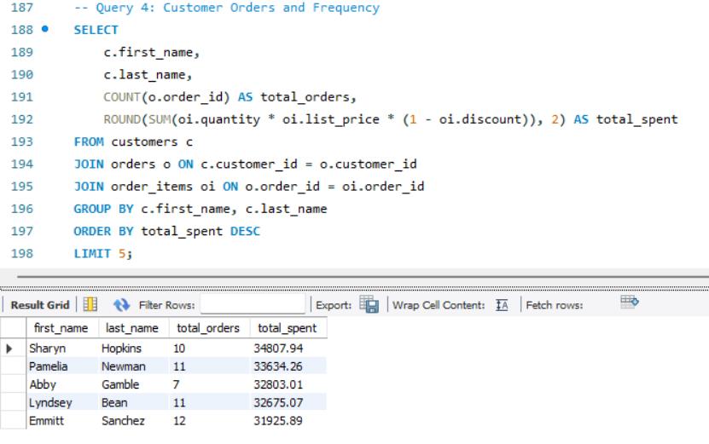
Insight 4 Customer Orders and Frequency (Top 5)

Slide 15
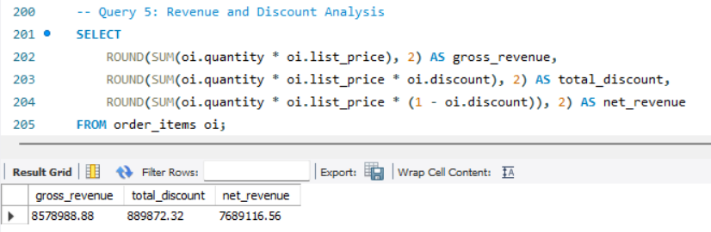
Insight 5
Revenue and Discount Analysis

Slide 16
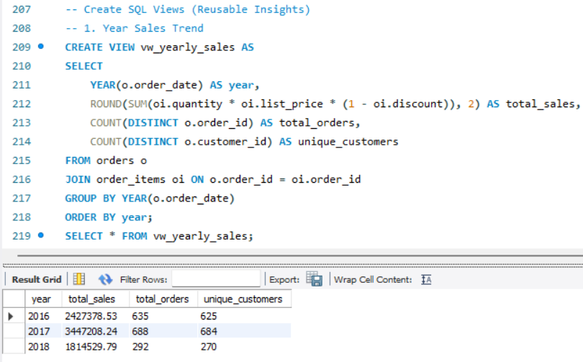
VIEWS-1. Monthly Sales Trend

Slide 17
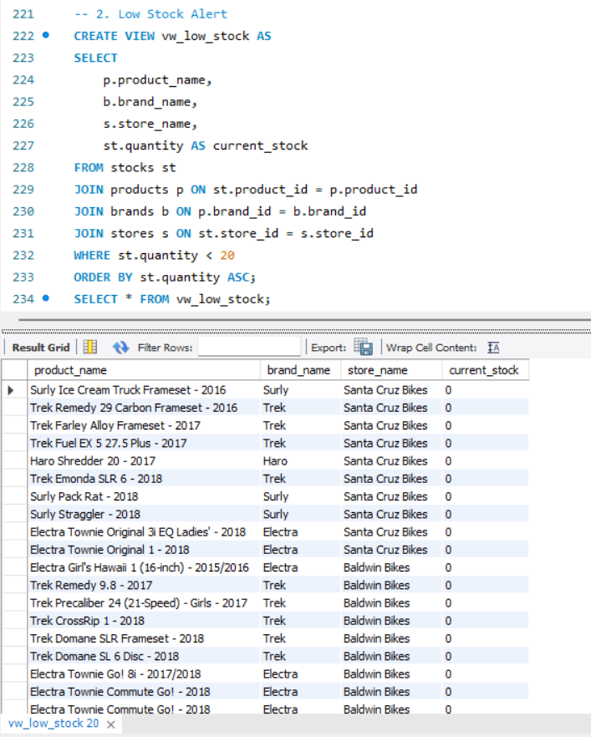
VIEW- 2. Low Stock Alert

Slide 18
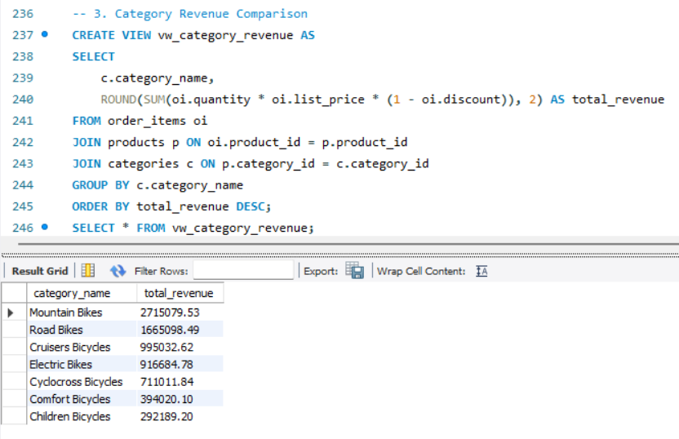
VIEW- 3. Category Revenue Comparison

Slide 19
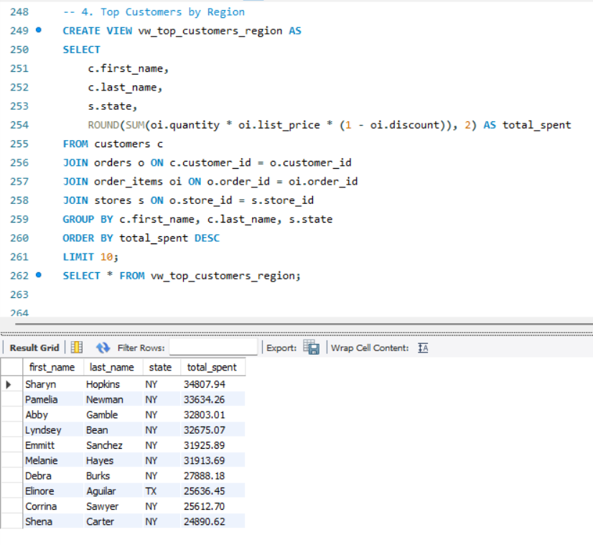
VIEW- 4. Top Customers by Region

Slide 20
Thank you
Himanshu
Domain- Data Analyst
hiimanshuu0406@gmail.com

